Slide 1

RUNGTA COLLEGE OF DENTAL SCIENCES AND RESEARCH
CASTING PROCEDURES DEFECTS AND METHODS OF COMPENSATION
DEPARTMENT OF CONSERVATIVE DENTISTRY AND ENDODONTICS

Slide 2
Specific learning Objectives
At the end of this presentation the learner is expected to know ;
Core areas* | Domain ** | Category #
Introduction, steps in casting, casting defects | Cognitive | Must know
Definitions, porosity | Psychomotor | Nice to know
Die materials, recent advances in casting | Affective | Desire to know

Slide 3
Contents.....
Introduction
History
Glossary of Prosthodontic terms
Basic cavity designs
Die Materials
Wax Pattern
Sprue Design
Casting Ring/ liners
Investments and procedures
Burn Out procedure
Casting Machine and Crucible
Ringless casting system
Casting Defects
Methods of Compensation
Recent Advances
Conclusion

Slide 4
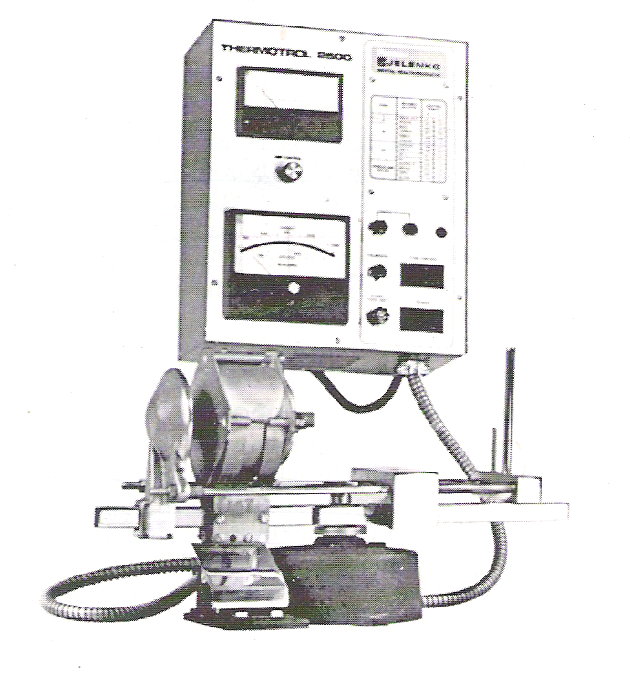
Spring wound Electric resistance heated casting machine
Electrical current is passed through a resistance heating element which causes melting of the alloy in the crucible.
Melts ceramic alloys in graphite crucible
Better temperature control & convenient
Prevents over heating
Oxidises the metal ceramic alloys on overheating
Crucible is against the casting ring - metal button remain molten slightly longer- complete solidification.
Carbon crucible not used with palladium alloys (melting temperature > 1504°C )

Slide 5
Direct current arc melting machine
An Electrical arc is created at the end of two electrodes – alloy and cooled tungsten electrode
Melts higher fusing alloys – temp within the arc exceeds 4000°C
Current is selected according to which alloy is being melted
Electrodes - attached both to negative &positive terminal.( placed about 5cm apart.)
High risk of over heating of alloy

Slide 6
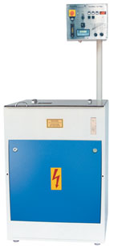
Induction casting
Melts base metal alloys of high melting temp.
The alloy is melted by an induction field that develops within a crucible surrounded by water cooled metal tubing.
The furnace consists of a transformer in which alternating current flows through the primary winding coil – variable magnetic field
Consists of crucible with copper coil wound circularly.

Slide 7
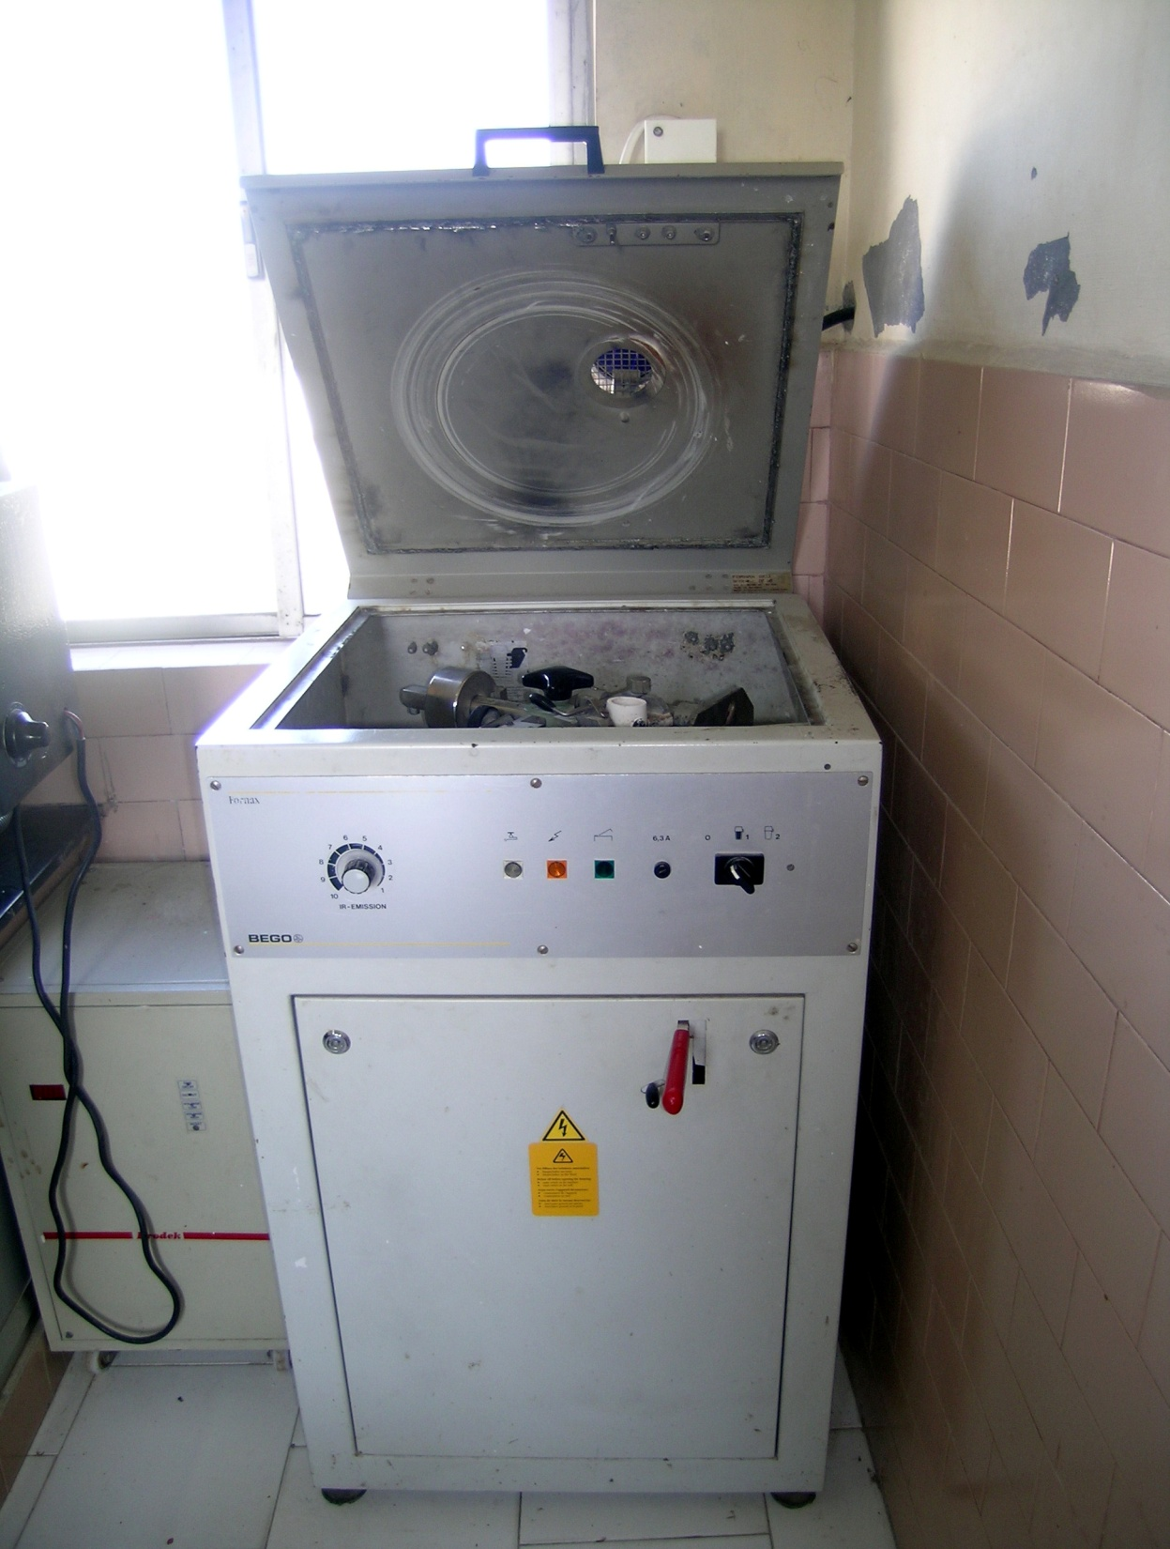
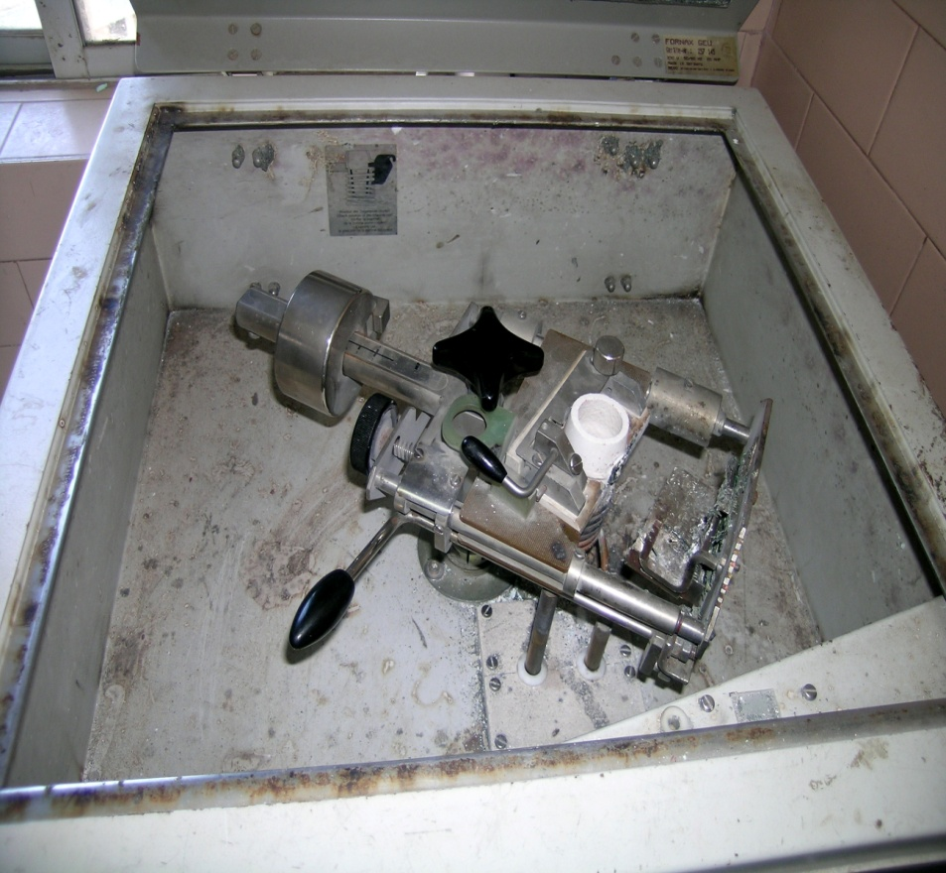
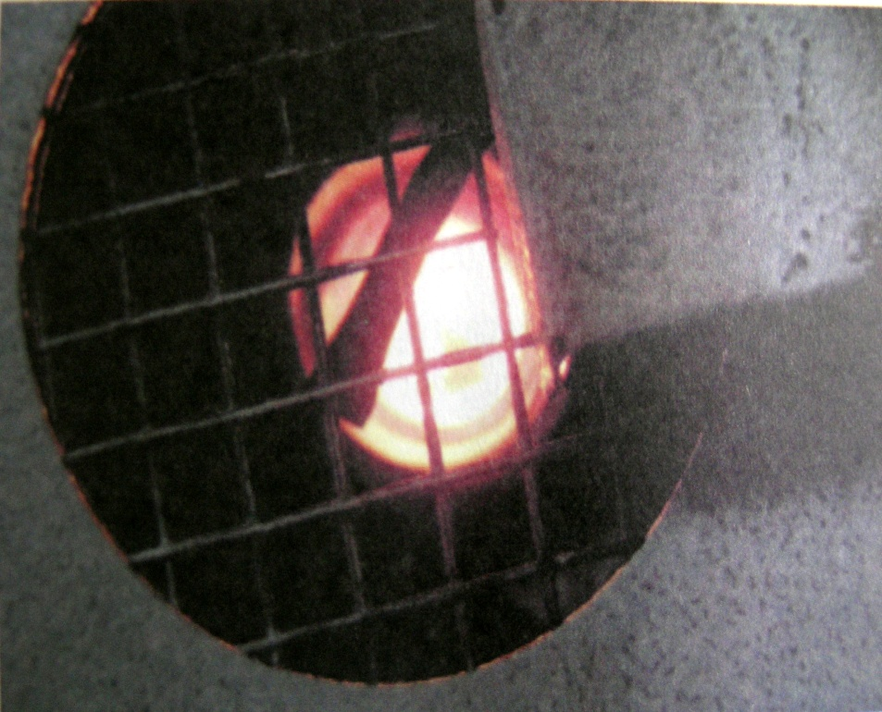

Slide 8
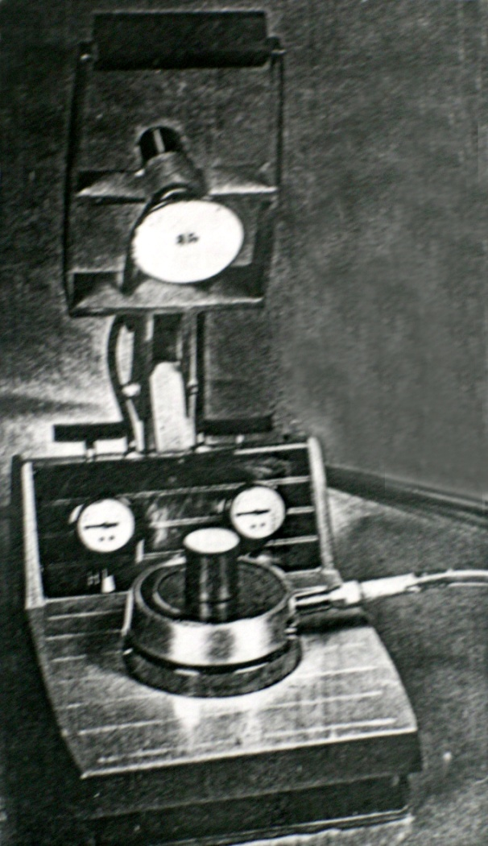
Vacuum or Air Pressure assisted casting machine
Alloy melted in the crucible hollow of the ring
Vacuum is applied at the base of the mold so that the flow of the molten alloys is helped by a suction from the base
Air tight piston – 10 – 15 psi (0.1 to 0.14 Mpa)
No pressure gradient
Heat transfer based on the thickness of the casting

Slide 9
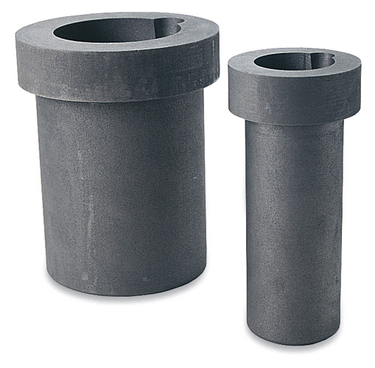
Crucibles
GPT - A vessel / container made of any refractory material (as porcelain) used
for melting / calcining any substance that requires a high degree of heat.
Carbon crucibles – for high noble crown and bridge & higher fusing gold-based metal ceramic alloys.
Not used with high pd /pd-Ag alloys and with Ni-Cr/Co-Cr base metal alloys.

Slide 10
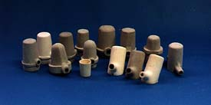
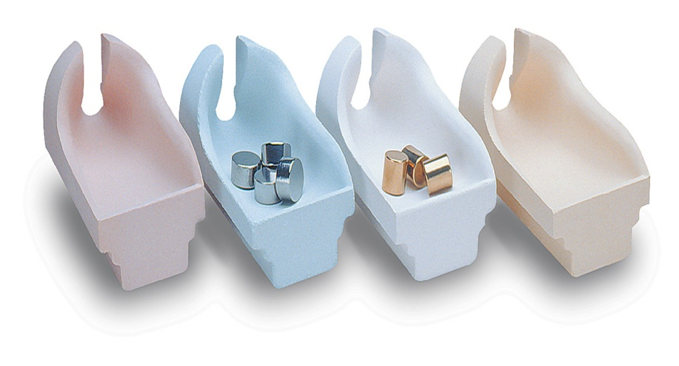
Clay crucibles - high noble and noble metal alloys
Quartz /zirconia - alumina crucibles - high-fusing alloys of any type ,base metal , palladium alloys

Slide 11
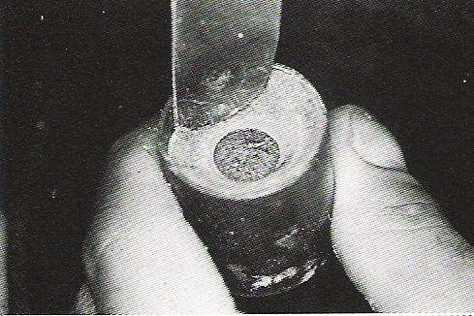
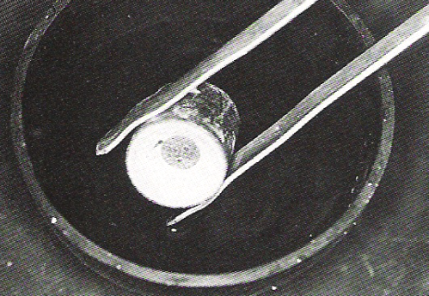
Divesting

Slide 12
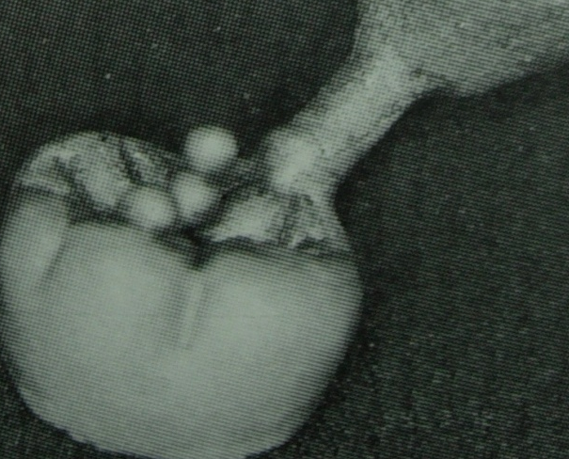
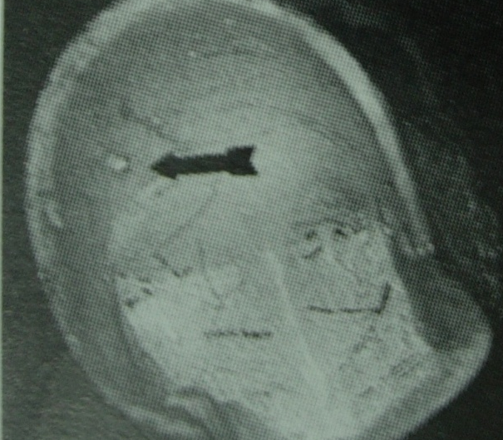
Nodules
Large nodules – air trapped during investing
Multiple nodules- inadequate vaccum
-improper brush tech.
-lack of surfactant
Nodules on occlusal surface- excessive vibration

Slide 13
Nodules
Large nodules – air trapped during investing
Multiple nodules- inadequate vaccum
-improper brush tech.
-lack of surfactant
Nodules on occlusal surface- excessive vibration

Slide 14
Water films
Appear as MINUTE RIDGES OR VEINS on the surface
If pattern is moved during investing
Lack of intimate contact of investment with wax pattern
Remedy – Surfactant
Increased W:P ratio

Slide 15
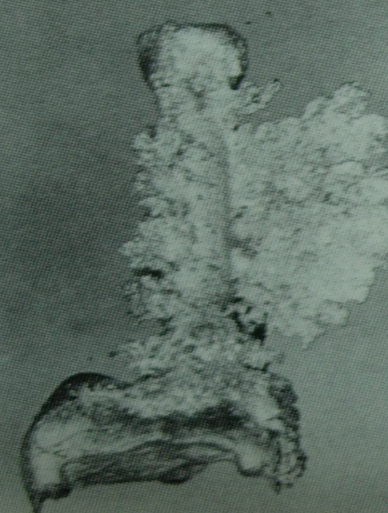

Fins / spines
Increased w/p ratio – ↓ Strength
Premature heating
Too rapid heating

Slide 16
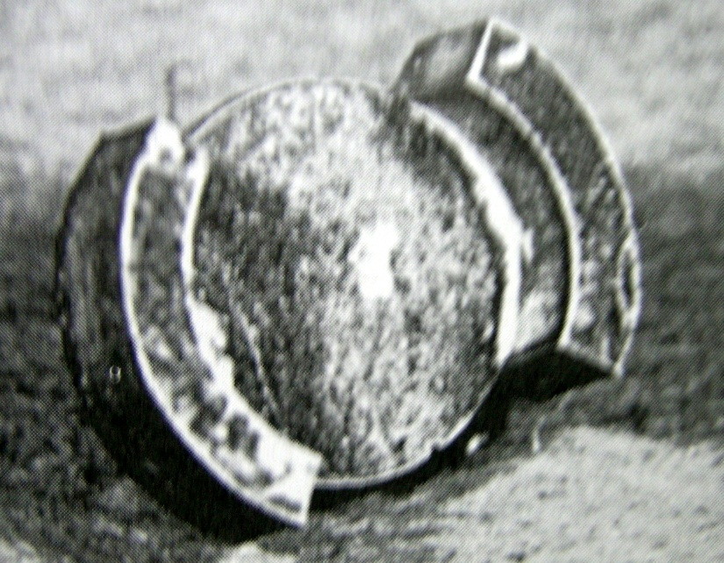
Discolouration
Contamination with gases when the
molten alloy comes in contact with the carbonaceous residue

Slide 17
Porosity
Solidification defects
      Localised shrinkage porosity
      Microporosity
Trapped gases
Gas inclusions
Subsurface porosity
Pinhole porosity
Residual air

Slide 18
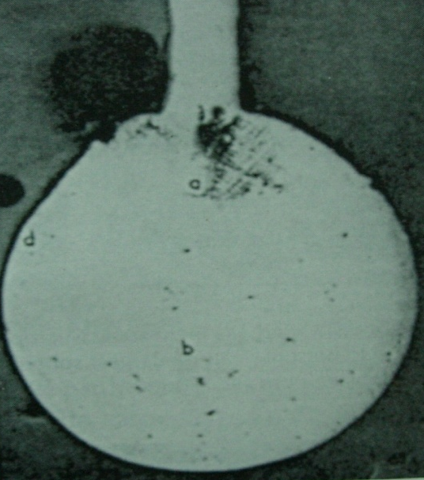

Localised shrinkage porosity
Premature termination of flow of metal
Occurs near sprue – casting junction
Microporosity
Occurs – rapid solidification
-low casting or mold temp.

Slide 19
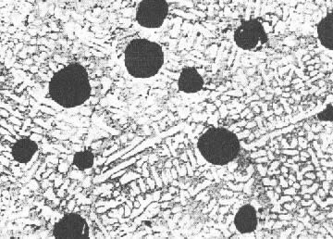
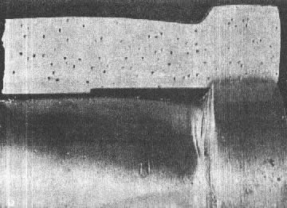
Pinhole/Gas inclusion porosity
Entrapment of gas during solidification
Many metals like Copper and Silver dissolve oxygen
Palladium has affinity to hydrogen

Slide 20
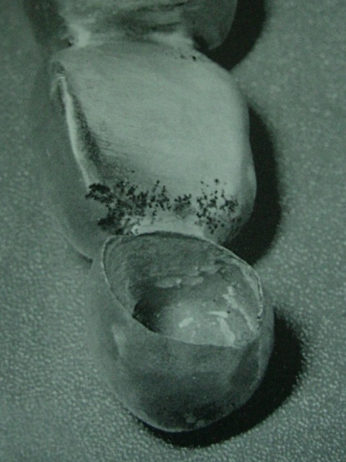
Subsurface porosity
Not established
Occurs- simultaneous nucleation of solid grains and gas bubbles along the mold walls

Slide 21
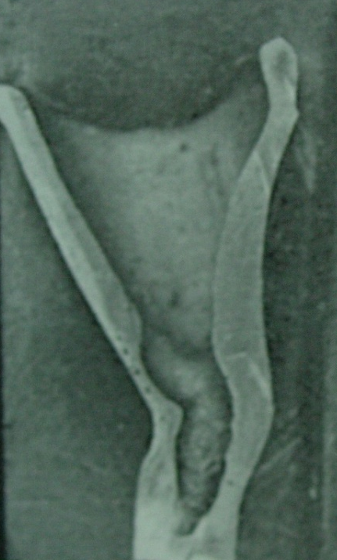

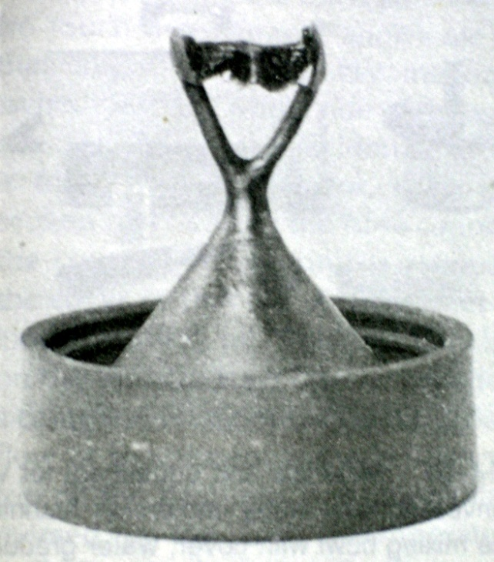
Suckback porosity
Occurs-occlusoaxial,incisoaxial line angle
Hot spot created

Slide 22
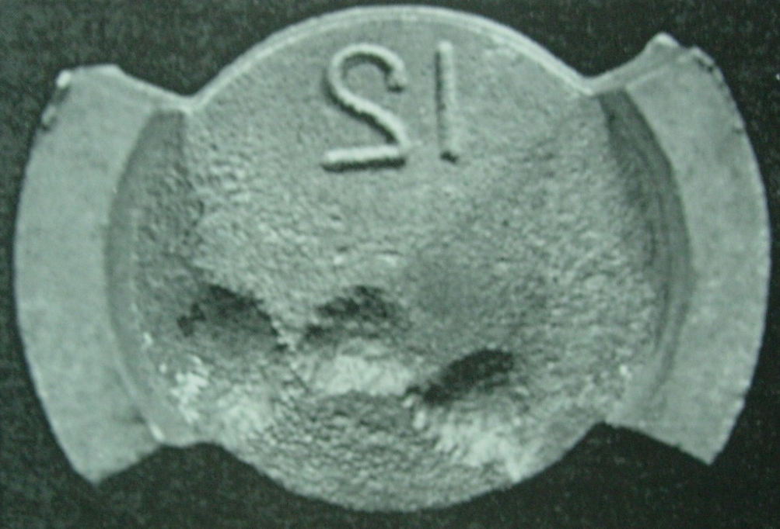
Back pressure porosity
Large concave depressions
Inability of the air to escape

Slide 23
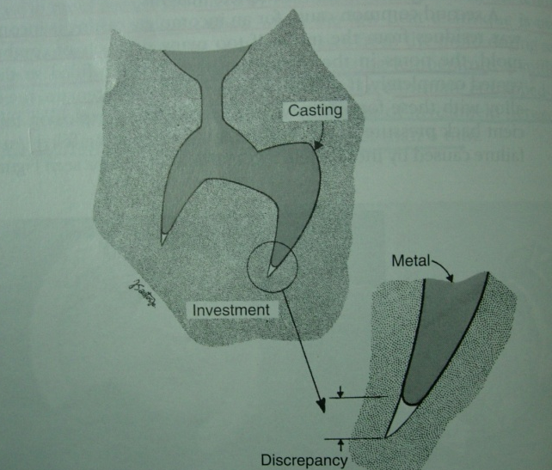
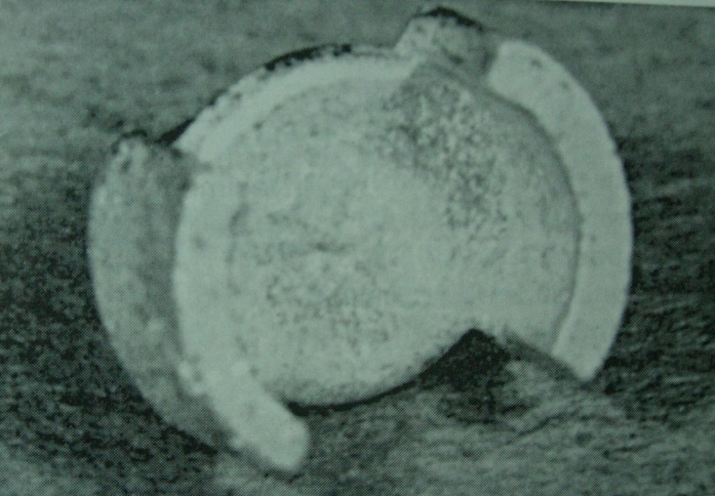
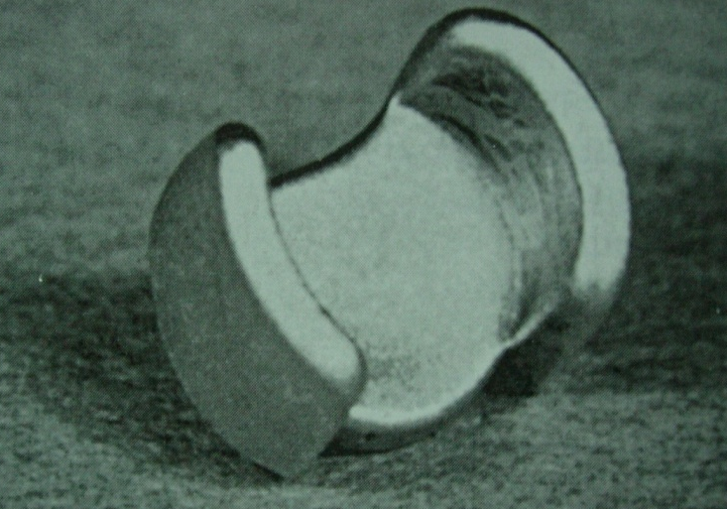
Incomplete casting
Insufficient venting of the mold
Incomplete elimination of wax residue
High viscosity of fused metal

Slide 24
Dimensional Change
Methods of Compensation
Wax shrinkage + Metal shrinkage = Wax expansion +
Setting expansion + Hygroscopic expansion + Thermal expansion

Slide 25
Casting Shrinkage
The thermal contraction of the liquid metal between the temperature to which it is heated and liquidus temperature
The contraction of the metal inherent in its change from the liquid to the solid state – solidification shrinkage
The thermal contraction of the solid metal that occurs on further cooling to room temperature
Linear Solidification shrinkage: - seen with various alloy
    Gold alloy → 1.5%
    Base metal alloy → 2.4%

Slide 26
Altering the die dimension
Adding accelerator (potassium sulfate) and retarder (borax) – reduce the SE to < 0.1%
Die Spacers - Resins in the paint-on liquids
        Model paint
        Coloured nail polish
        Thermoplastic polymers dissolved in volatile
        solvents

Slide 27



Plastic cylinder former composed of 3 parts:
  Crucible former with orientation mark,
  Tapered ring
  Release ring.
Packages of 3 are available in three sizes:
Small: height 56mm, 38mm Ø, RED
Large: height 60mm, 54mm Ø, GREEN
XLarge: height 54mm, 64mm Ø, GREEN
Extra Large Large Small

Slide 28


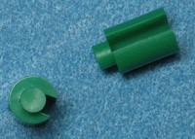


Large Plastic Small Plastic
Roto Slotted Sprue
Large Wax Small Wax

Slide 29
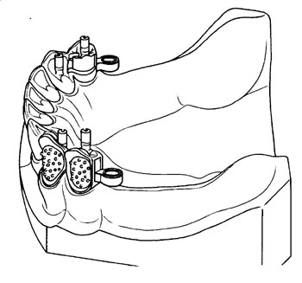
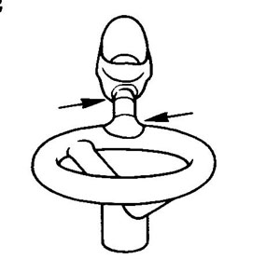
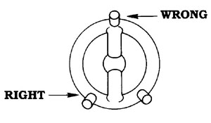
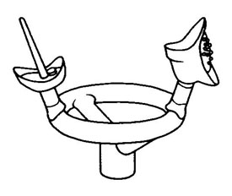

Slide 30
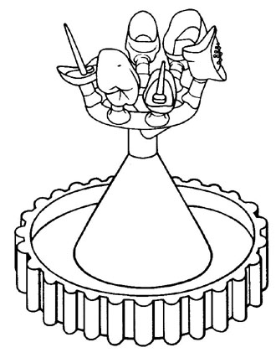
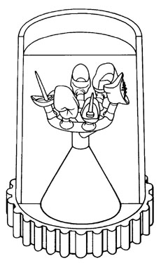
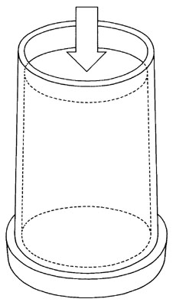

Slide 31
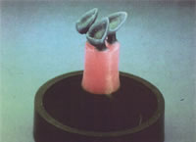
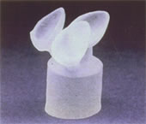
Castable ceramics - Dicor
Commercially available - Dicor by Corning Glass works, Dentsply.
A castable glass – formed into an inlay, facial veneer, or full crown by lost wax tech.
Glass casting core sandblasted and sprue removed
Protective embeddment material – Ceramming
Checked for the fit – Veneering porcelain
55 vol% of tetrasilicic fluormica crystals

Slide 32
Castable glass ceramics
Phosphate bonded investment material-1.6% thermal expansion.
2 stage burnout
    Initial temperature - 480F(250°C) – heat soaking of investment for 30min.
    Final temperature – 1750F (950°C) – heat soaking for 2 hrs

Slide 33
TAKE HOME MESSAGE
Cast restorations meet the needs of patients who require, for one or more reasons, the replacement of a rather large amount of tooth tissue. The manner of casting fabrication, by the indirect or direct methods, material selection throughout the process and their manner of use is a choice for the experienced operator. Knowledge of the advantages and disadvantages of certain techniques and materials, thoughtful exercise of the basic principles guiding their application, and critical assessment of the results of practice will help assure the highest quality of this form of restorative care.

Slide 34
QUESTIONS
Define Cast metal restorations
Classify metals used in cast metal restorations
Discuss Ideal properties of metals in cat metal restorations
List various casting defects. Methods to overcome them.
Define Porosity….types and its prevention
Types of Cast Metal Restorations.
Inlay wax

Slide 35
REFERENCES
Science Of Dental Materials -----By ANUSAVICE, Skinners.
Restorative Dentals Materials 11th Edition By Craig.
Operative Dentistry 2nd Edition By Summit, Robbins, Schwarts

Slide 36
SUGGESTED READING
Science Of Dental Materials -----By ANUSAVICE, Skinners.
Restorative Dentals Materials 11th Edition By Craig.

Slide 37
Thank You

